Slide 1

12:34
12:39
12:49
12:52

Slide 2



Slide 4



Slide 5








Slide 8


Slide 9
Helsinki 12:30
http://www.fontspace.com/category/thin?p=2
http://www.fontspace.com/nimavisual/trench

Slide 10




Slide 11





Slide 14






Slide 15
M

Slide 16


Slide 17



Slide 18


Slide 19





Slide 20


Slide 25





Slide 26


Slide 27



Slide 38



Slide 39


Slide 40


Slide 41


Slide 44


Slide 45


Slide 46







Slide 47





Slide 48


Ewket Apps
®
Ewket Apps
®

Slide 49










Slide 51




Slide 52


Slide 53



Slide 55

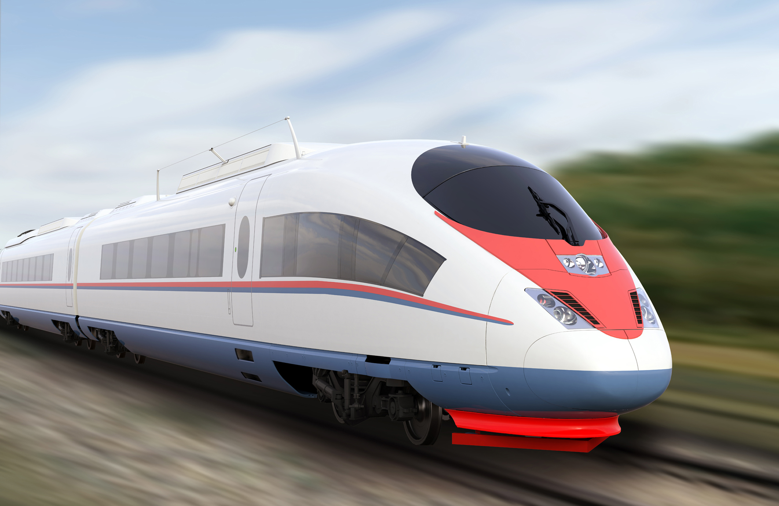

Slide 57
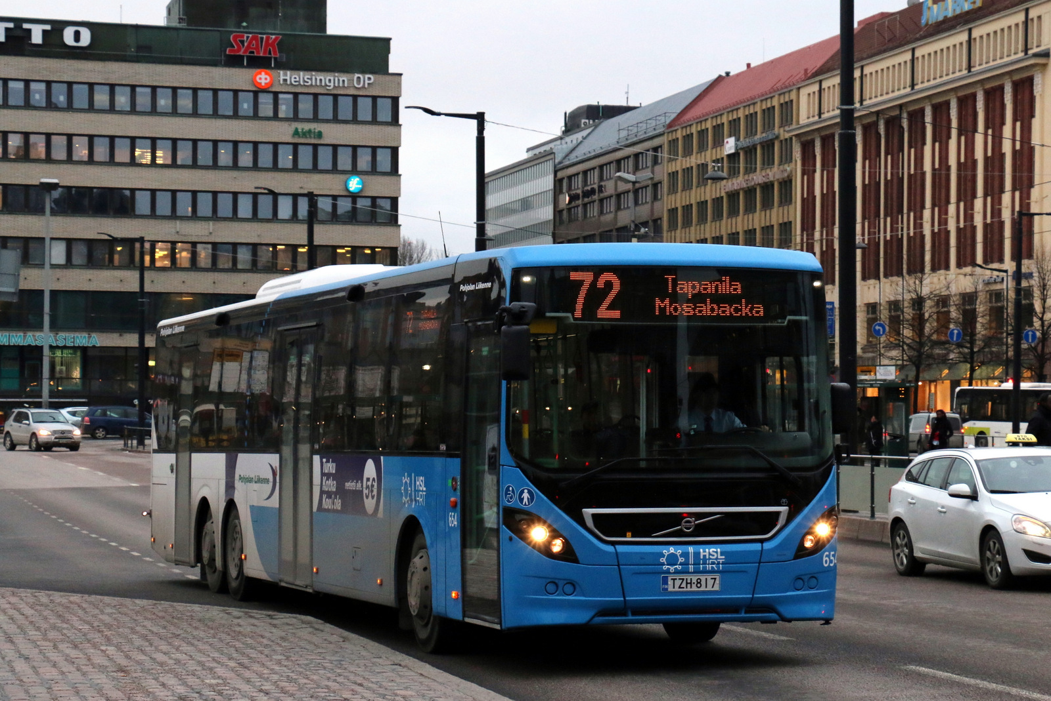

Slide 59


Slide 60
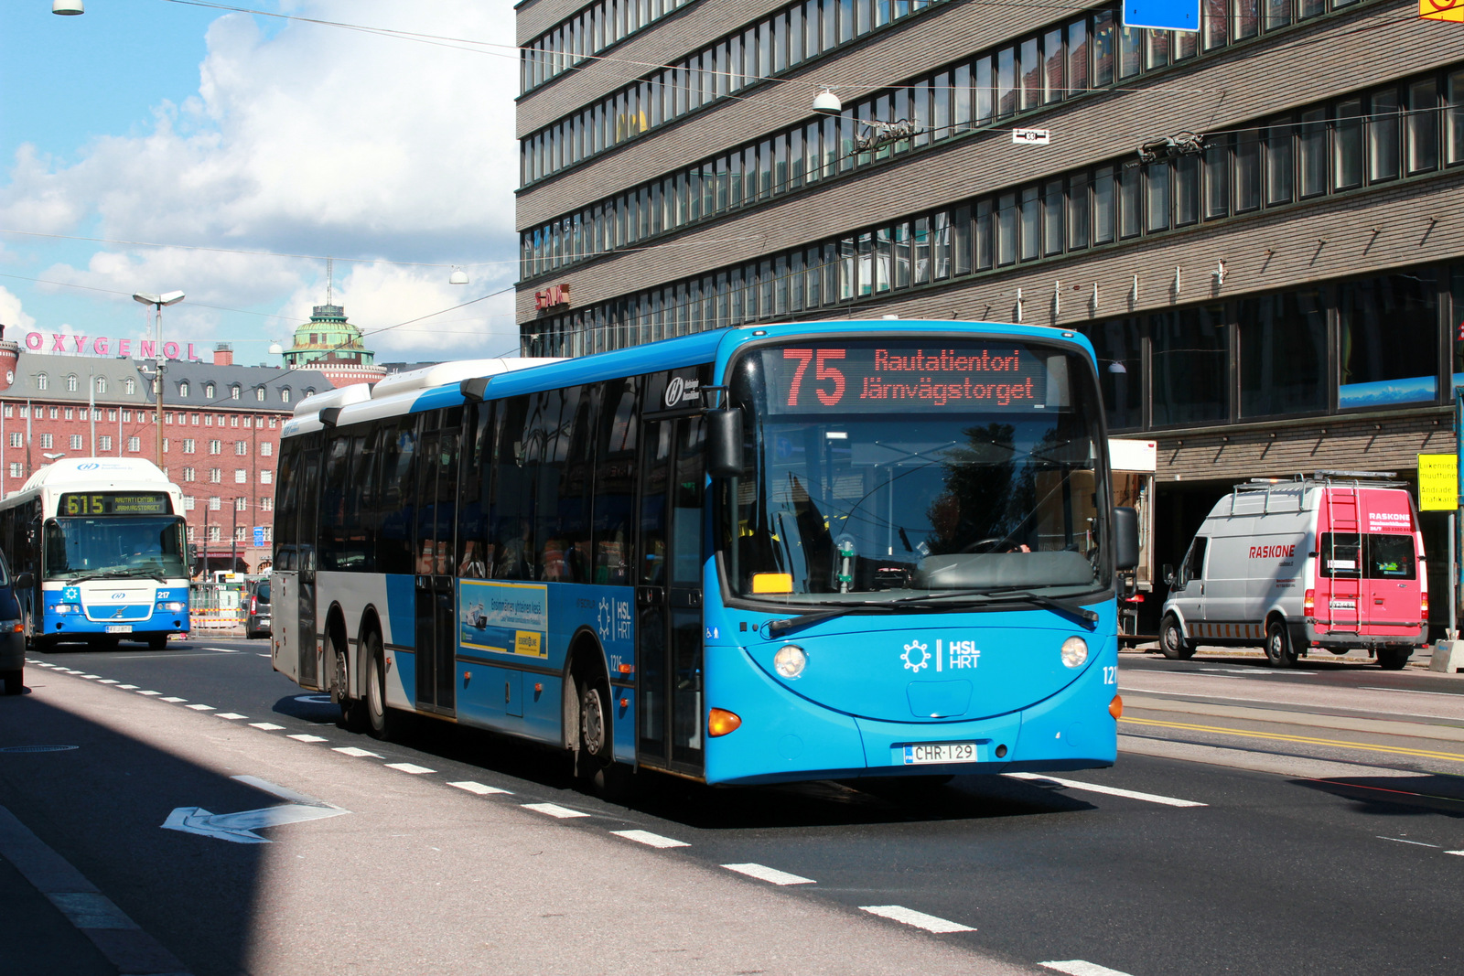

Slide 61


Slide 62


Slide 64
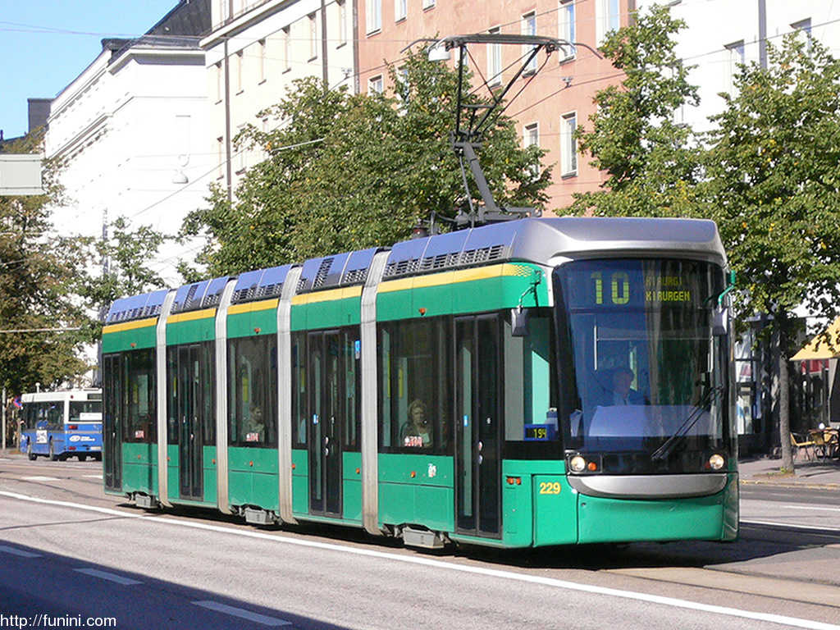

Slide 66


Slide 68
C
B
A - > C
B -> X
X = (b * C)/A
Dif = (A – B)/2
A
C * (1 – B/A)/2

